Slide 1
Implementing HTTP Services in Node.js
PRESENTED BY:
SUMEHRA
CSE-D
22H51A05C2

Slide 2
Introduction to Node.js
Node.js is an open-source, cross-platform runtime environment that allows you to run JavaScript on the server-side.
It is built on Chrome's V8 JavaScript engine, which executes JavaScript code efficiently.

Slide 3
HTTP
HTTP (Hypertext Transfer Protocol) is a fundamental protocol of the Internet, enabling the transfer of data between a client and a server.
It is the foundation of data communication for the World Wide Web. HTTP provides a standard between a web browser and a web server to establish communication.
Data such as text, images, and other multimedia files are shared on the World Wide Web. Whenever a web user opens their web browser, the user indirectly uses HTTP.
It is an application protocol that is used for distributed, collaborative, hypermedia information systems.

Slide 4
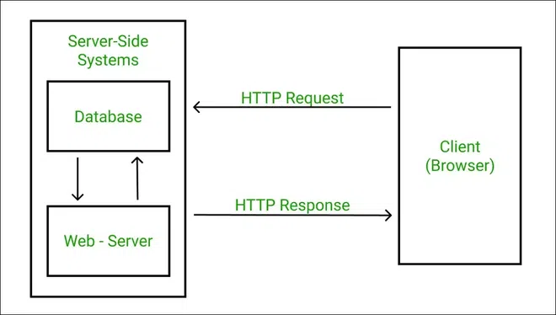

Slide 5
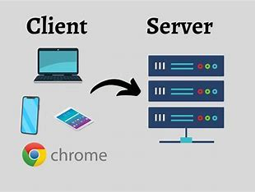
Node.js HTTP Module
The HTTP module in Node.js provides utilities for creating HTTP servers and clients. It’s a fundamental part of Node.js, enabling the handling of HTTP requests and responses.

Slide 6
HTTP Module
To make HTTP requests in Node.js, there is a built-in module HTTP in Node.js to transfer data over the HTTP. To use the HTTP server in the node, we need to require the HTTP module. The HTTP module creates an HTTP server that listens to server ports and gives a response back to the client.
Syntax:
const http = require('http');

Slide 7
Creating Servers:
The HTTP module allows you to create a server using the http.createServer() method, which listens for incoming requests and handles them using a callback function.
Handling Requests:
You can handle HTTP requests and responses by accessing the request and response objects within the callback function of createServer(). The request object contains data from the client, while the response object is used to send data back.

Slide 8
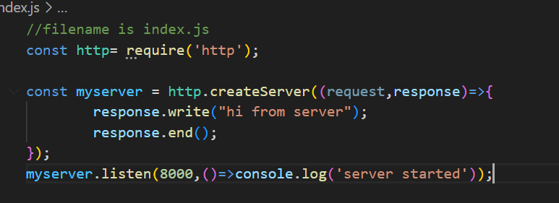
Creating an HTTP server with the help of http.createServer() method.

Slide 9

Run this index.js file using the below command:
node index.js
Output:
Console Output:
Browser Output:

Slide 10
Conclusion
The HTTP module is essential for Node.js developers, providing powerful tools for creating and managing HTTP servers and clients. Its versatility and integration capabilities make it a cornerstone of Node.js application development.

